Slide 1
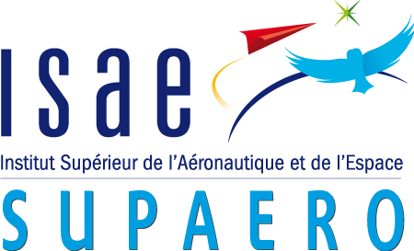
Multifidelity aeroelastic optimization with application to a BWB
Research project presentation
Author: Gilberto ruiz jiménez
Supervisors: Joseph morlier & Joan mas colomer

Slide 2
Contents
Introduction
State of the art
Previous work
Proposed method
Results
Conclusions & Future work

Slide 3
Introduction
Fluid-Structure Interaction (FSI) is a key feature in aircraft design.
Uncertainties on the aeroelastic behaviour lead to excessive safety margins.
In order to optimize w.r.t. aeroelastic behaviour, the coupled system must be solved many times.
Ideally, this analysis should be carried out from the very early stages of the design phase.
Additional costs
Non-optimal structure

Slide 4

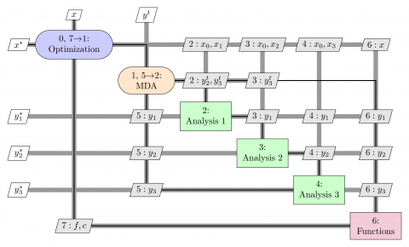
Introduction: Multidisciplinary Optimization
Methodology for the design of systems where the interaction between several disciplines must be considered [3] Gray et al. AIAA/ISSMO
An MDO architecture:
Decomposes a complex system in manageable parts
Coordinates the parts interactions
Searches the overall system optimum
OpenMDAO
Python-based, open source framework for coupling multiple models and optimization
Figure 2. XDSM diagram, MDF architecture. [3] Gray et al. AIAA/ISSMO

Slide 5
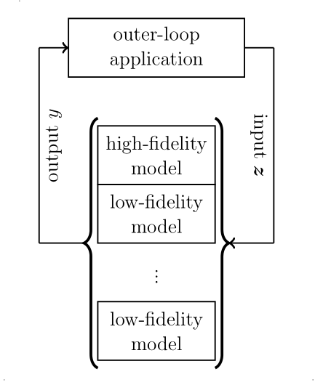
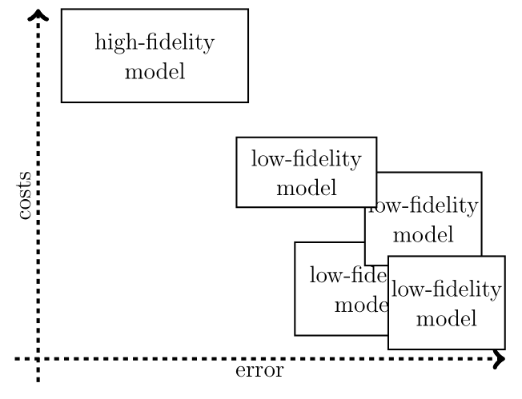
Goal of the Project.
MDO libraries allow the user to couple both disciplines and optimize w.r.t. established bounds & variables
High-Fidelity simulations offer accurate results but are often too expensive for direct design optimizations.
Low-Fidelity analysis offer reasonable approximations with low computational demands.
This project aims to combine low and high-Fidelity analysis to conduct aeroelastic optimization, and apply the method to a BWB configuration.
Figure 2. Multifidelity methods leverage error and costs to speedup simulations. [7] Peherstorfer et al. SIAM Review

Slide 6
Contents
Introduction
State of the art
Previous work
Proposed method
Results
Conclusions & Future work

Slide 7
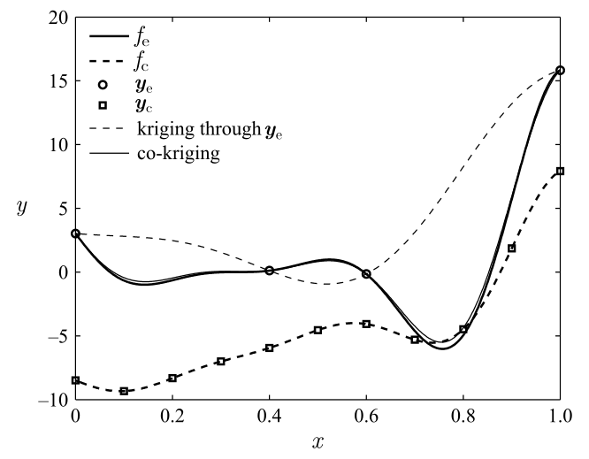
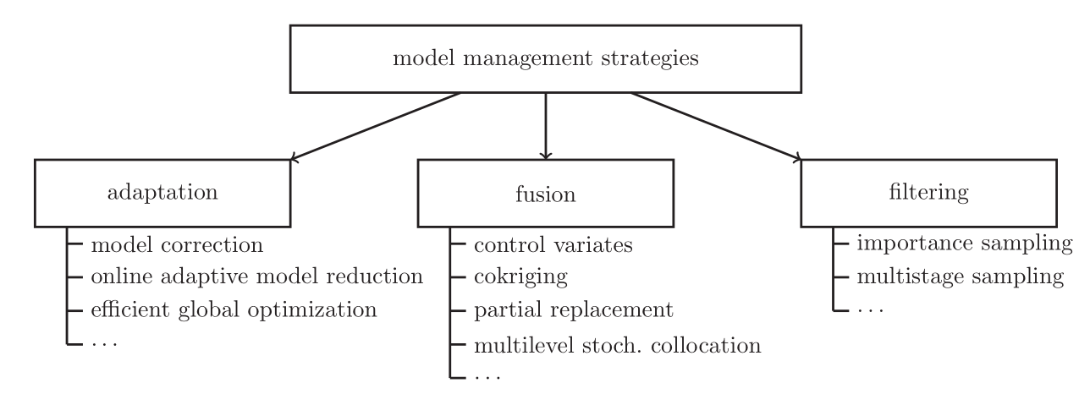
State of the art
There are many kinds of multifidelity strategies:
Adaptation: Use some Hi-Fi runs to transform the Lo-Fi solutions so that they fit the expected Hi-Fi field.
Fusion: Run some Lo-Fi iterations up to a given criteria, then transfer to Hi-Fi
Filtering: Execute some Lo-Fi runs and determine which are significant, then transfer to Hi-Fi field.
Figure 3. Kriging and co-kriging are fusion methods that combine low and high-Fidelity models.
[2] Forrester et al. Proc. Royal Soc. Lond
[7] Peherstorfer et al. SIAM Review
Notes:
Our strategy is a filtering method

Slide 8
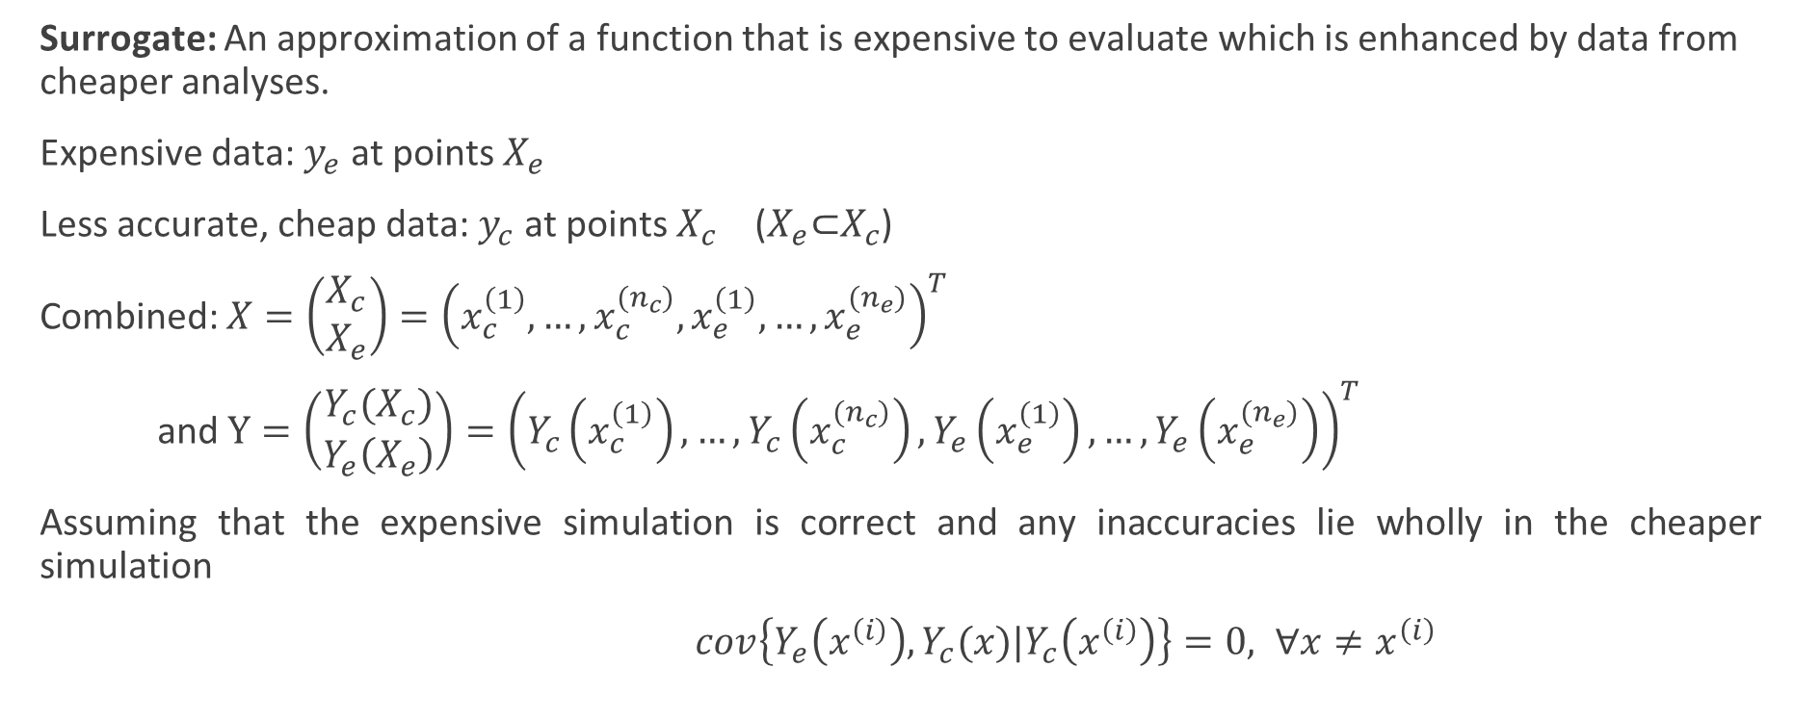
State of the art: Co-kriging
Surrogate: An approximation of a function that is expensive to evaluate which is enhanced by data from cheaper analyses.
Expensive data: $y_{e}$ at points $X_{e}$
Less accurate, cheap data: $y_{c}$ at points $X_{c}$ ($X_{e}\text{⊂}X_{c}$)
Combined: $X=\left(\begin{matrix}X_{c} \\ X_{e}\end{matrix}\right)={\left(x_{c}^{\left(1\right)},…,x_{c}^{{(n}_{c})},x_{e}^{\left(1\right)},…,x_{e}^{{(n}_{e})}\right)}^{T}$
and $Y=\left(\begin{matrix}Y_{c}(X_{c}) \\ Y_{e}\left(X_{e}\right)\end{matrix}\right)={\left(Y_{c}\left(x_{c}^{\left(1\right)}\right),…,Y_{c}\left(x_{c}^{{(n}_{c})}\right),Y_{e}\left(x_{e}^{\left(1\right)}\right),…,Y_{e}\left(x_{e}^{{(n}_{e})}\right)\right)}^{T}$
Assuming that the expensive simulation is correct and any inaccuracies lie wholly in the cheaper simulation
$cov\left\{Y_{e}\left(x^{\left(i\right)}\right),Y_{c}(x)|Y_{c}\left(x^{\left(i\right)}\right)\right\}=0, ∀x≠x^{\left(i\right)}$
[2] Forrester et al. Proc. Royal Soc. Lond.

Slide 9
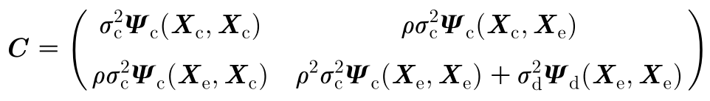
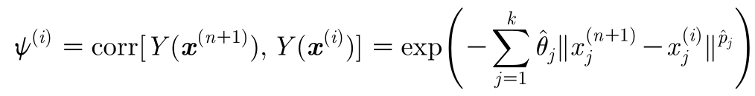
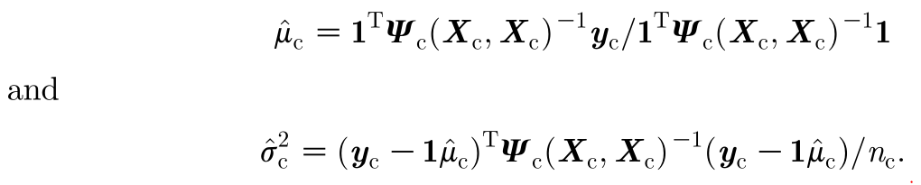

State of the art: Co-kriging
Expensive code = cheap code multiplied by a scaling factor ρ plus a Gaussian process $Z_{d}$
$$Z_{e}\left(x\right)=ρZ_{c}\left(x\right)+Z_{d}\left(x\right)$$
With the covariance matrix:
In order to find the hyperparameters, maximize ln-likelihood
Yielding:
[2] Forrester et al. Proc. Royal Soc. Lond.

Slide 10
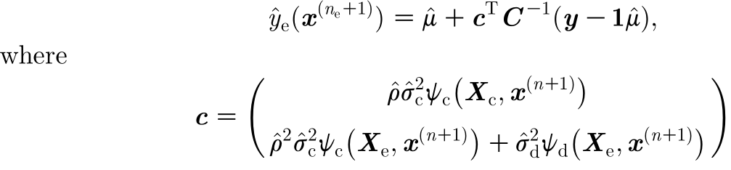

State of the art: Co-kriging
With the hyper-parameters estimated, the co-kriging prediction of the expensive function is given by:
[2] Forrester et al. Proc. Royal Soc. Lond.

Slide 11
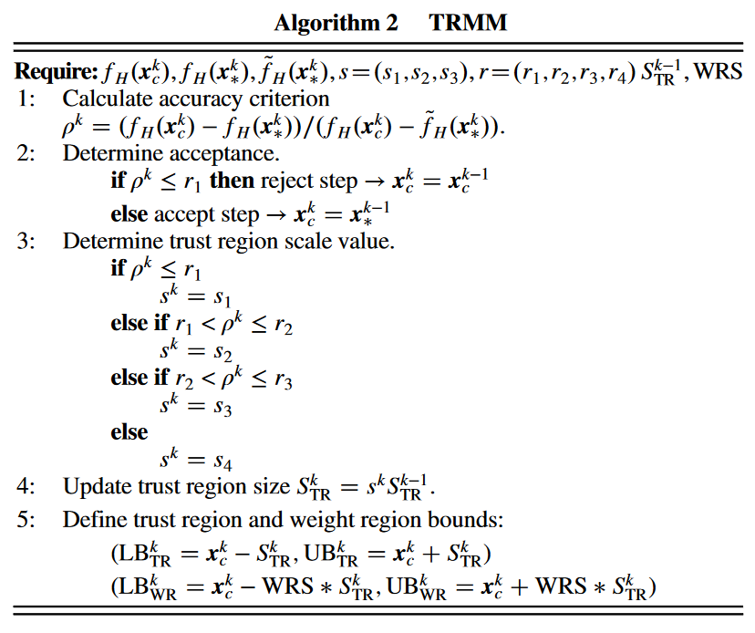
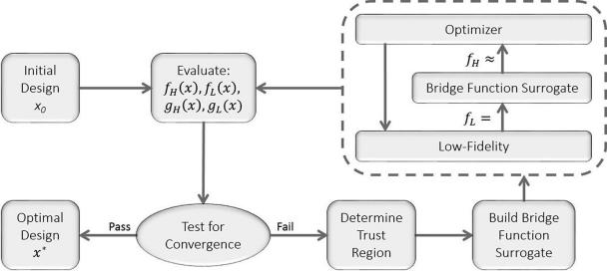
State of the art: Trust Region Model Management (TRMM)
[1] Fischer et al. AIAA

Slide 12
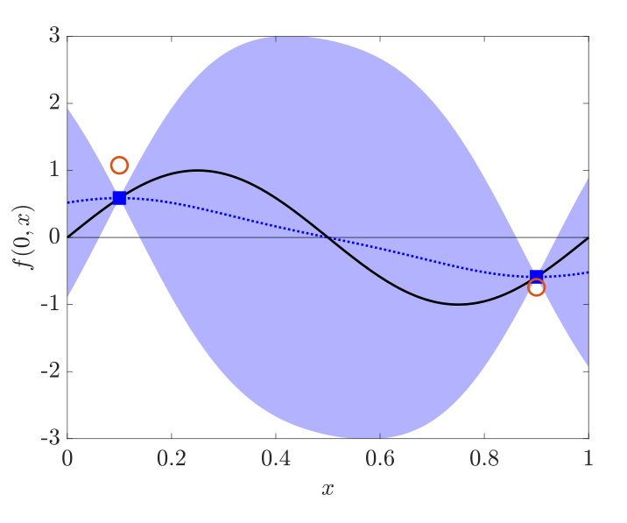
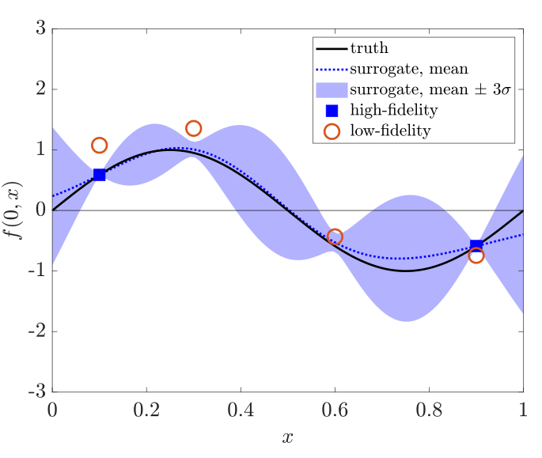
State of the art
Quasi-Newton Inverse Least Squares algorithm (QN-ILS)
ASM-ILS [8] Scholcz et al. Comput. Methods Appl. Mech Engrg.
Defect-correction [4] Jovanov & De Breuker, AIAA
Some other alternatives:
The linear regression approach: balances accuracy, cost and simplicity [9] Zhang et al. AIAA
Active learning approach: The flutter boundary can be found if treated as a contour location problem [5] Marques et al. AIAA
Figure 4. Low-Fidelity data improves prediction of High-Fidelity function. [5] Marques et al. AIAA
Notes:
ASM: Agressive Space Mapping
TRMM: Thrust Region Model Management

Slide 13
Contents
Introduction
State of the art
Previous work
Proposed method
Results
Conclusions & Future work

Slide 14
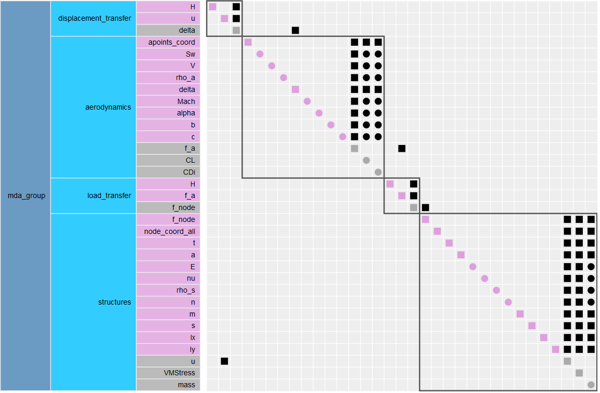
Previous work
The main base for the development of this project is the aerostructures package [6] Mas-Colomer Univ. Toulouse
Python library, facilitates the creation of MDA and MDAO problems in OpenMDAO.
Combines structural solvers (NASTRAN) with fluid solvers (Panair, ADFlow)
A simple example of the implementation of this python library was provided by the author for both the low and high fidelity cases.
Figure 5. $N^{2}$ Diagram of the MDA for the sample problem. Generated using OpenMDAO.

Slide 15
Previous work
The structure module computes nodal displacements.
As both disciplines do not share the same mesh topology, loads and displacements cannot be directly exchanged.
Radial Basis Functions
One module interpolates the displacement field from the structural nodes to the aerodynamic points
Another one transfers the aerodynamic loads to the structural nodes while preserving the total load and moment
The coupled system is solved using iterative methods readily available in the OpenMDAO platform.
Gauss-Seidel
Notes:
given the geometry of the structure, its material properties, and the input nodal forces
To exchange loads and displacements, we use the method based on the radial basis functions (RBF)

Slide 16
Contents
Introduction
State of the art
Previous work
Proposed method
Results
Conclusions & Future work

Slide 17
Proposed method
Most of the state of the art methods consider the solvers as black boxes, and require stochastic treatment and/or surrogates.
The advantage of OpenMDAO, NASTRAN95, ADFlow and Panair: They are Open-Source Tools, we can make changes from the inside.
Why not leverage this advantage to connect both fidelities at the MDA level?
Start
PANAIR
Initial disp.
Fidelity Change
AdFlow
Inherit PANAIR solution
Outer Loop Optimizer
Final solution

Slide 18
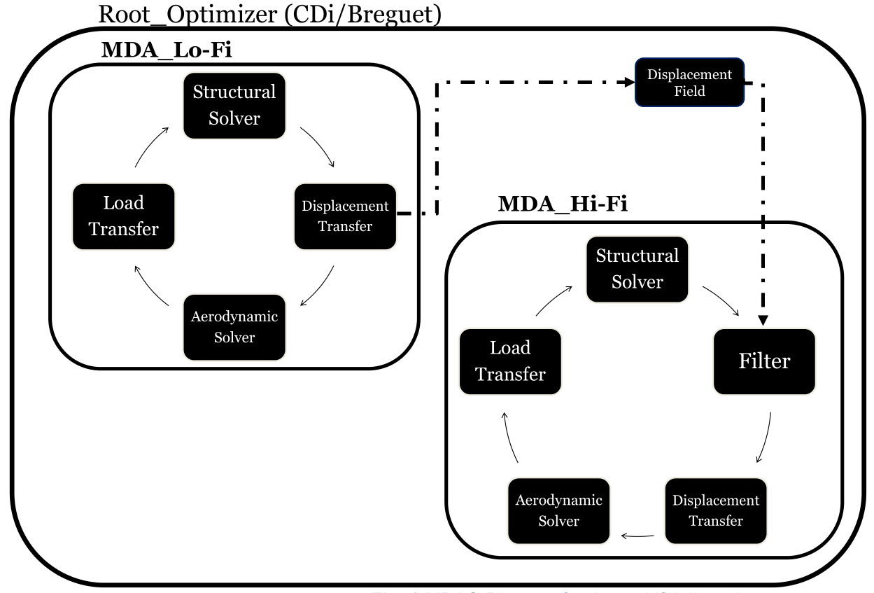
Proposed method
A Filter component is added to the MDAO, it inherits the structural displacement field from the last low fidelity run.
The switch between fidelities happens when the tolerance for each MDA is achieved.
Only parameters that need to be set by the user: the tolerances for each MDA.
All in all, the simplicity of the method w.r.t. stochastic methods is evident.
Hi-Fi runs can run either with a refined PANAIR mesh or with full CFD (ADflow).
Figure 6. MDAO Architecture proposal.

Slide 19
Contents
Introduction
State of the art
Previous work
Proposed method
Results
Conclusions & Future work

Slide 20
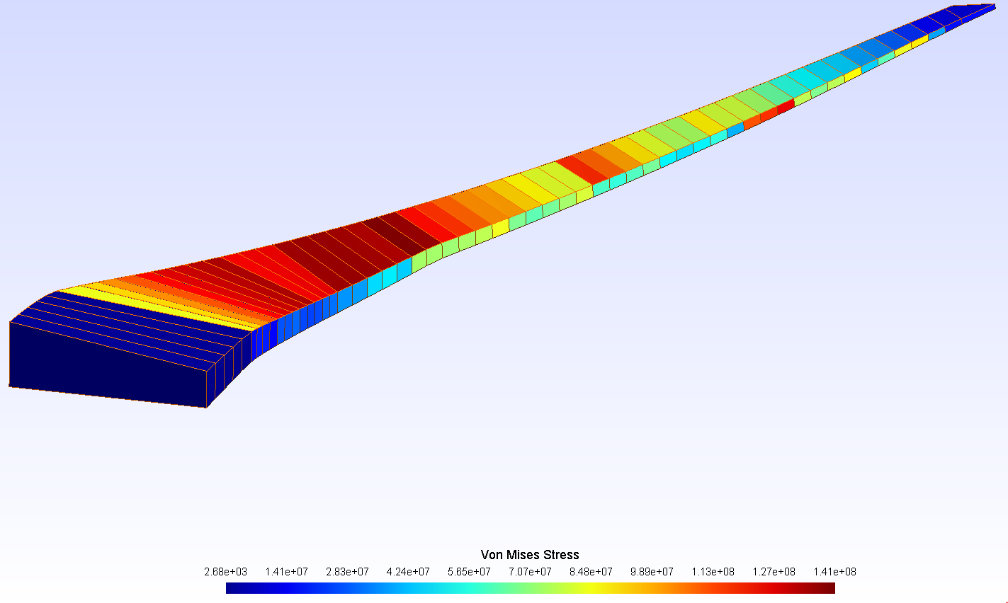
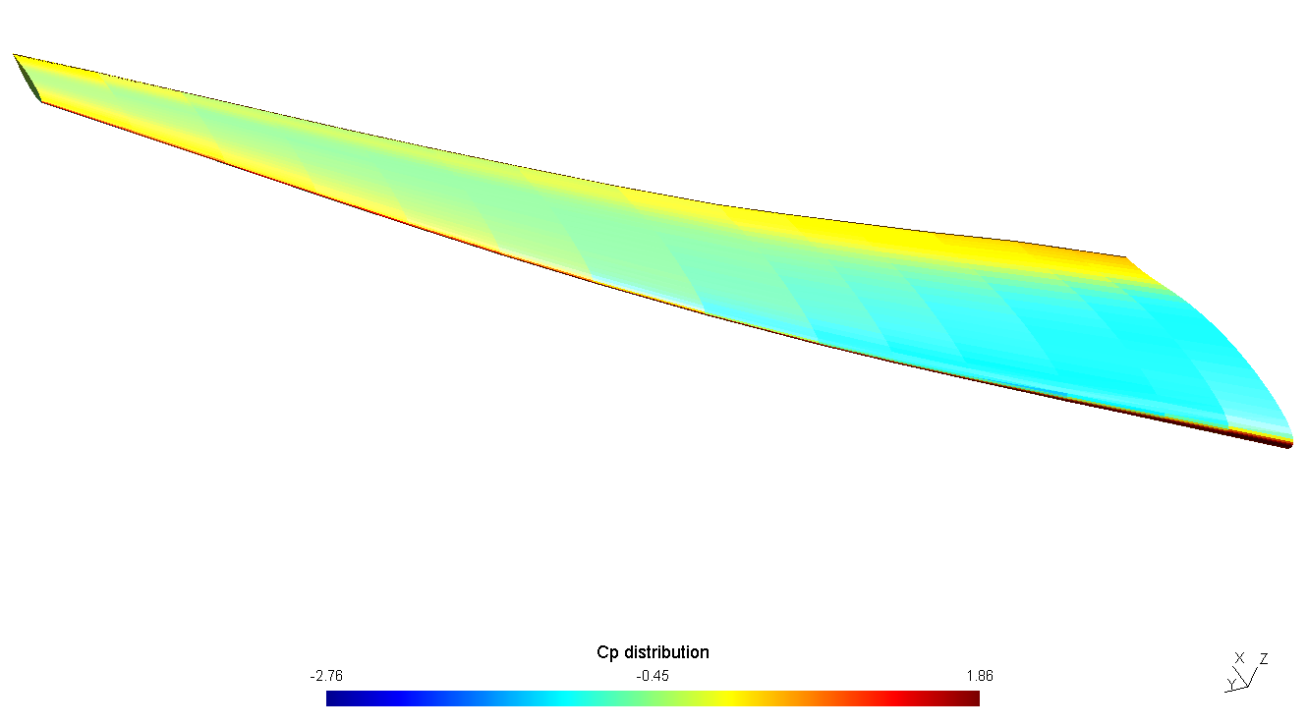
Results: CRM wing
The wing section is modelled flying at cruise conditions, the objective is to minimize the induced drag. (See details in the Jupyter Notebook).
An optimal solution was found for the problem in multifidelity mode, with Panair acting as the solver for both fidelities (see Fig. 7-8)
The Hi-Fi solution results from a refined aerodynamic mesh.
A Panair—Adflow variant was explored, but convergence problems at the aerodynamic level arose when the optimizer introduced large displacements.
Figure 7. Von Mises Stress on the sample wing problem (NASA CRM), multifidelity optimization Panair--Panair. Structural Mesh.
Figure 8. Cp distribution on the sample wing problem, multifidelity optimization Panair--Panair. Aerodynamic Mesh.

Slide 21
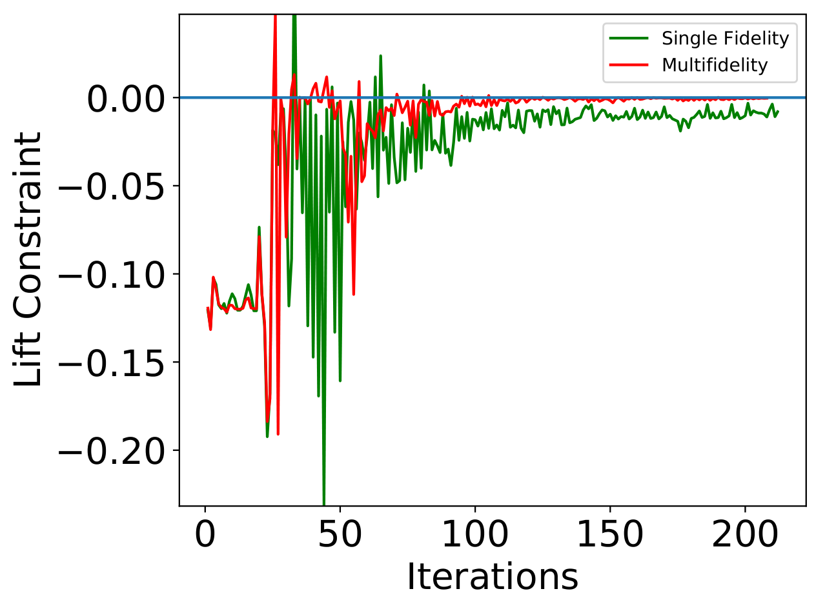
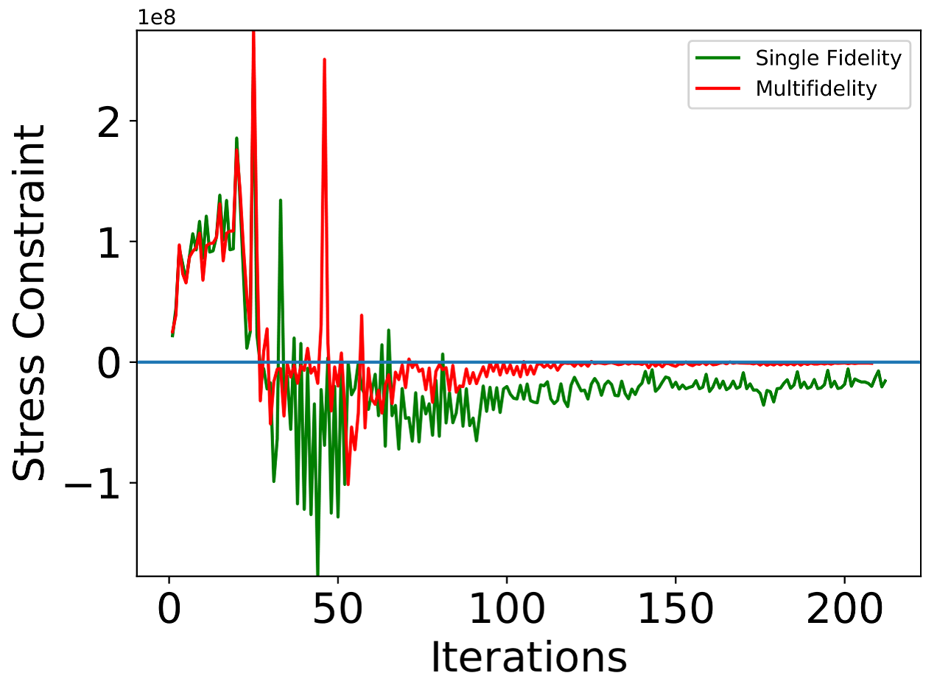
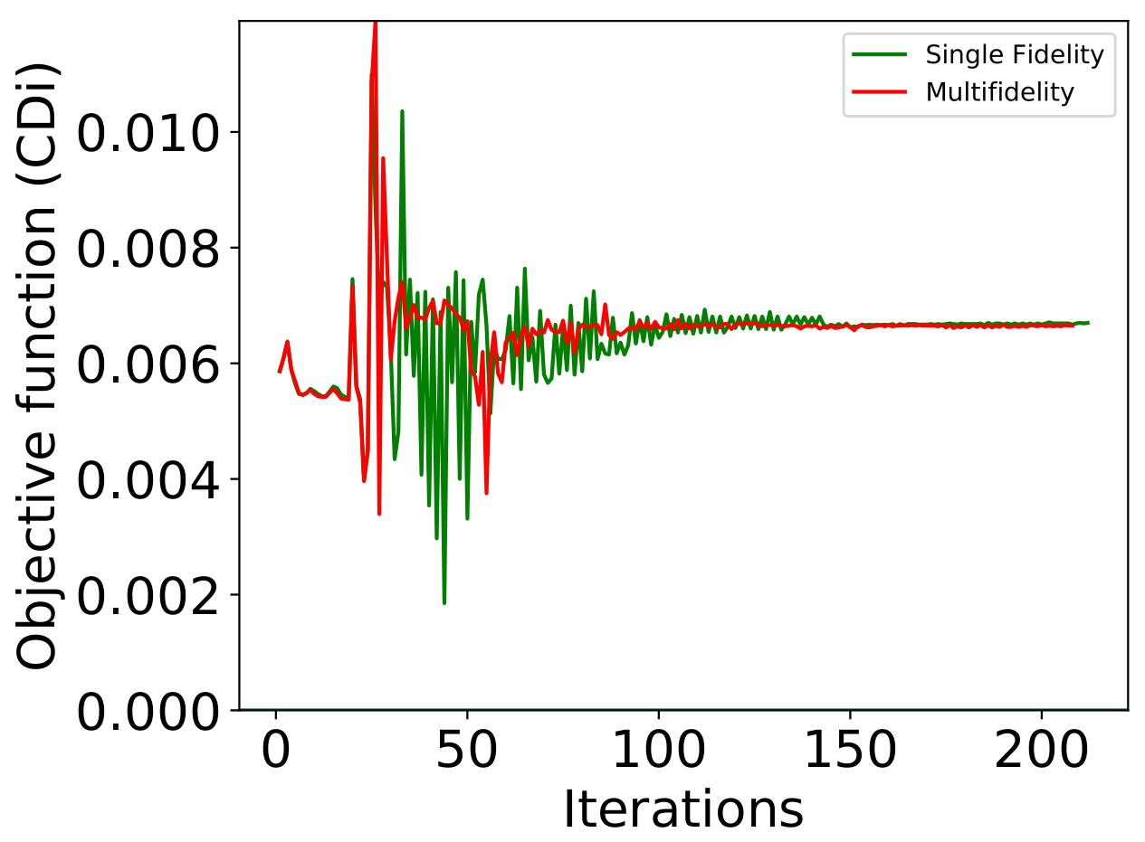
Results: CRM wing
In this case, the optimization objective was the induced drag.
Convergence of the objective function is similar in both fidelities.
The improvement of the method came in the constraint compliance plots: multifidelity gets closer to zero, and faster.
Figure 9. Solution controls for the CRM wing problem, single fidelity and multifidelity cases.

Slide 22
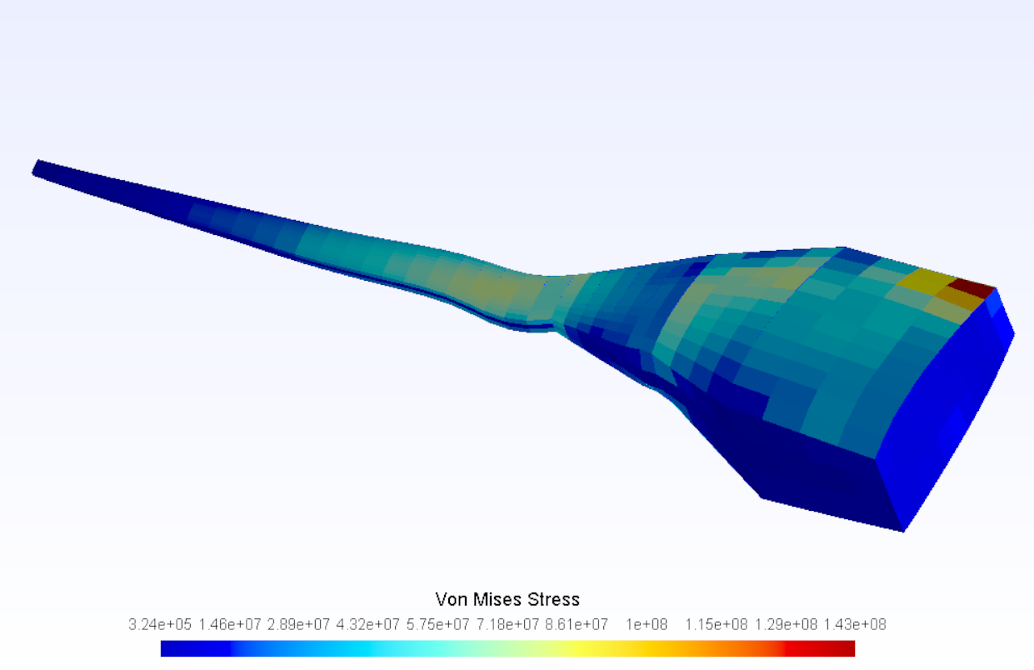
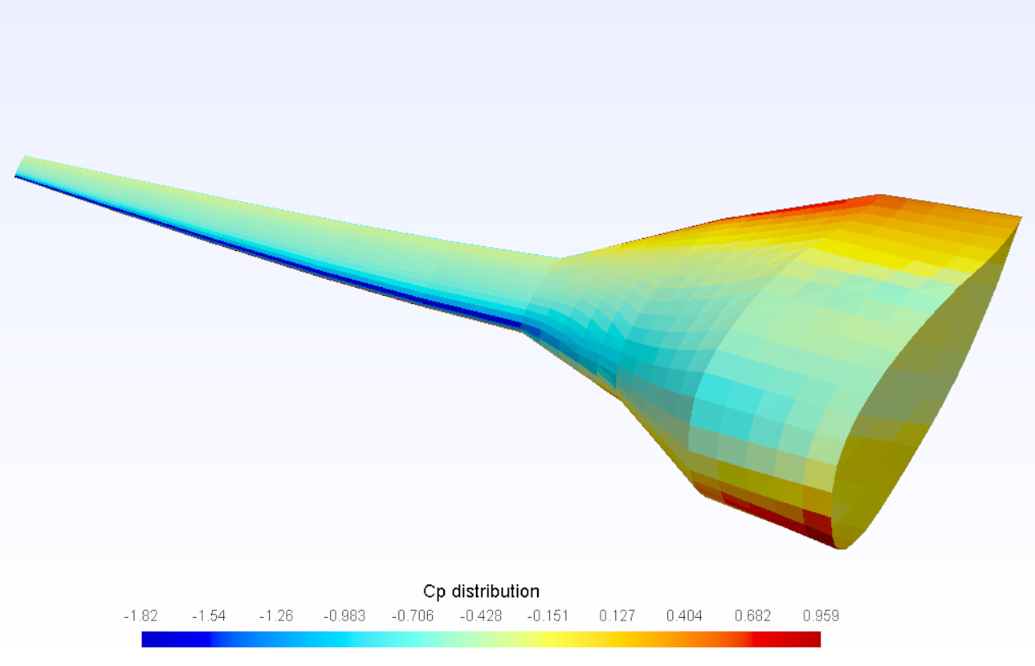
Results: Blended Wing Body
The optimization of the BWB is carried out to minimize fuel consumption (Breguet equation). All the parameters are detailed in the Jupyter Notebook.
A single fidelity run converged successfully to the results shown in Fig. 10-11.
Refinement of the aerodynamic mesh caused the geometry to exhibit non-convex panels that prevented PANAIR from finding Cp distributions.
No multifidelity run was possible, when trying to use Adflow, the displacements of the structured induced by the optimizer generate aerodynamic geometries with flow singularities.
Figure 10. Von Mises Stress on the Blended Wing Body, multifidelity optimization Panair--Panair. Structural Mesh.
Figure 11. Cp distribution on the Blended Wing Body, multifidelity optimization Panair--Panair. Aerodynamic Mesh.

Slide 23
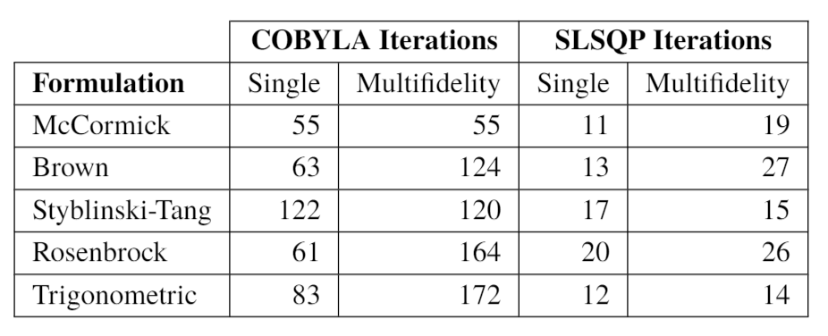
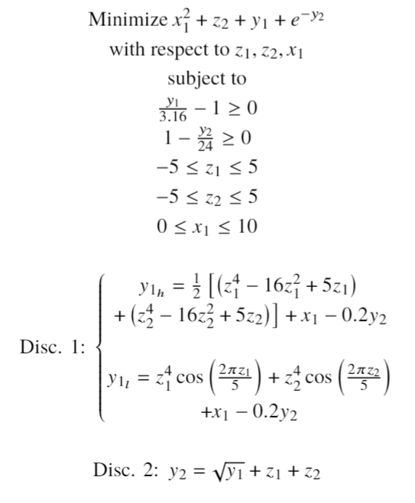
Results: Analytical Formulations
Table 1. Optimizer iterations needed to converge to a minimum, various problem formulations.
Some analytical problems [10] were optimized using the multifidelity strategy presented here.
It was found that the performance of the method relies heavily on the shape of the low and high Fidelity functions.
Tab. 1 summarizes the results in terms of iterations to converge, with the Styblinski-Tang problem exhibiting improvements.
The tests were implemented with two different optimization alorithms, as expected, SLSQP converges faster because it uses the analytical gradient.
Problem 1. Styblinski-Tang formulation [10]

Slide 24
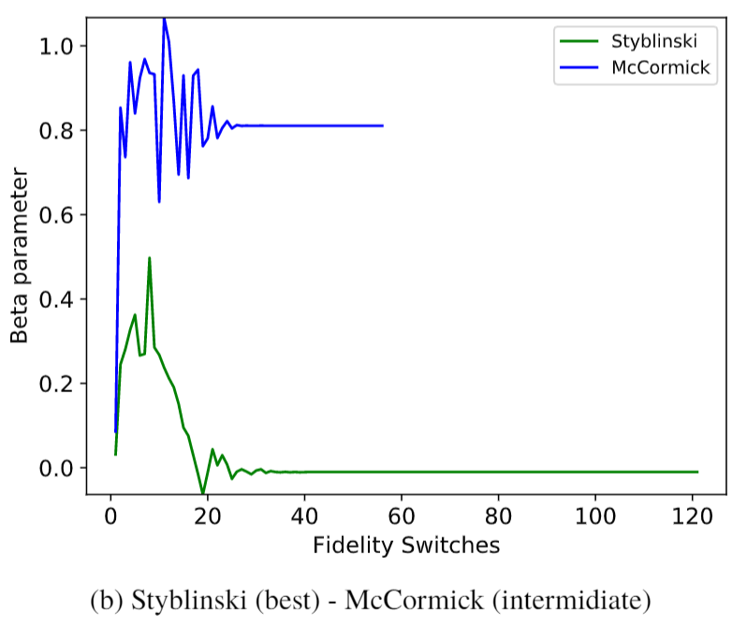
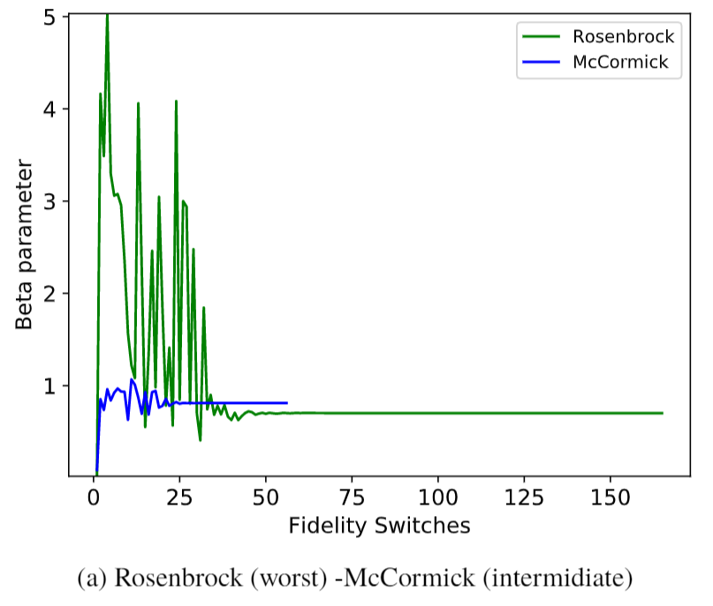

Results: Analytical formulations
With the aim of establishing a criterion that characterizes good or bad combinations of multifidelity functions, a parameter was proposed and calculated at each Fidelity switch:
$β=\frac{y_{2}\left(y_{1_{h}}\right)}{y_{2}\left(y_{1_{l}}\right)}$
Best performance occurs with beta values between 0 – 1 (Fig 12 a)
Bad performance was observed for values well above 1, as with the Rosenbrock problema (Fig. 12 b)
Figure 12. Comparison of the Beta parameter evolution as a function of the fidelity switches during the optimization run.

Slide 25
Contents
Introduction
State of the art
Previous work
Proposed method
Results
Conclusions & Future work

Slide 26
Conclusions and future work
Constraint compliance is the main part of the MDAO problem that benefits from the proposed technique.
Even if the optimizer calls are not reduced a lot, the simplicity of implementation is unlike any other existing strategies.
The performance of this method is highly reliant on the local characteristics of the low and high fidelity functions.
Controlling the morphing of the structural part could help render the problem more stable in the aerodynamic part.
Constraining the solution of the structural part is a way of doing this, but one must be careful not to over-constraint the structure to a point where the solution is no longer useful.
Future improvement: Use the Beta parameter to scale the lo-fi solution to values that are closer to the Hi-Fi ones. (Correction strategy)

Slide 27
Documentation, tutorials, & extended results
RP GitHub: Contains the tutorials, results and full report in article format.
https://github.com/mid2SUPAERO/RP_MAE_GILBERTO_RUIZ_JIMENEZ
Modified Aerostructures Package with the Filter component for multifidelity applications:
https://github.com/mid2SUPAERO/aerostructures/tree/g.ruiz

Slide 28
Bibliography
[1] Fischer, C. C., Grandhi, R. V., & Beran, P. S. (2018). Bayesian-Enhanced Low-Fidelity Correction Approach to Multifidelity Aerospace Design. AIAA Journal, 56(8), 3295-3306.
[2] Forrester, A. I., Sóbester, A., & Keane, A. J. (2007). Multi-fidelity optimization via surrogate modelling. Proceedings of the royal society a: mathematical, physical and engineering sciences, 463(2088), 3251-3269.
[3] Gray, J., Moore, K., & Naylor, B. (2010, September). OpenMDAO: An open source framework for multidisciplinary analysis and optimization. In 13th AIAA/ISSMO Multidisciplinary Analysis Optimization Conference (p. 9101).
[4] Jovanov, K., & De Breuker, R. (2015). Accelerated convergence of static aeroelasticity using low-fidelity aerodynamics. In 56th AIAA/ASCE/AHS/ASC Structures, Structural Dynamics, and Materials Conference (p. 0175).
[5] Marques, A. N., Lam, R., Chaudhuri, A., Opgenoord, M. M., & Willcox, K. E. (2019). A multifidelity method for locating aeroelastic flutter boundaries. In AIAA Scitech 2019 Forum (p. 0438).
[6] Mas-Colomer, J. (2018). Aeroelastic Similarity of a Flight Demonstrator via Multidisciplinary Optimization (Doctoral dissertation, Université Fédérale de Toulouse).
[7] Peherstorfer, B., Willcox, K., & Gunzburger, M. (2018). Survey of multifidelity methods in uncertainty propagation, inference, and optimization. SIAM Review, 60(3), 550-591.
[8] Scholcz, T. P., van Zuijlen, A. H., & Bijl, H. (2014). Space-mapping in fluid–structure interaction problems. Computer Methods in Applied Mechanics and Engineering, 281, 162-183.
[9] Zhang, Y., Kim, N. H., Park, C., & Haftka, R. T. (2018). Multifidelity Surrogate Based on Single Linear Regression. AIAA Journal, 56(12), 4944-4952.
[10] Bryson, D. E., and Rumpfkeil, M. P., “Multifidelity Quasi-Newton Method for Design Optimization,”AIAA Journal,Vol. 56, No. 10, 2018, pp. 4074–4086. https://doi.org/10.2514/1.j056840.

